Slide 1
Plasma Stability Study #2
Raw Data Summary
Molly Grun
04 Nov 2025

Slide 2
Stability Summary
% Monomer by SEC
Change in % Monomer
Molecule | Plasma Stability (days) |  |  | Buffer Stability (days)
 | 0 | 3 | 7 | 0 | 3 | 7
SI-212T14 | 75 | 63 | 49 | 89 | 85 | 84
SI-54X1 | 91 | 81 | 79 | 94 | 88 | 85
SI-212X19 | 90 | 77 |  | 94 | 88
SI-212X13 | 87 | 82 | 77 | 93 | 89 | 85
SI-50E15 | 89 | 79 | 70 | 95 | 95 | 92
SI-212X20 | 83 | 62 |  | 91 | 66
SI-212T12 | 82 | 63 | 60 | 96 | 86 | 78
SI-212SF1 | 87 | 82 | 56 | 98 | 90 | 89
SI-212X23 | 82 | 66 | 68 | 95 | 90 | 88
SI-212T26 | 75 | 71 | 65 | 89 | 83 | 83
SI-212T15 | 85 | 78 | 72 | 97 | 89 | 87
SI-212T29 |  | 71 | 68 | 88 | 83 | 78
SI-207X7 | 82 | 35 | 13 | 94 | 81 | 77
SI-207X8 | 80 | 34 | 17 | 92 | 92 | 61
SI-207X9 | 86 | 32 | 15 | 96 | 83 | 81

Slide 3
Stability Summary – HMW and LMW
% Aggregate by SEC
% Fragment by SEC
Molecule | Plasma Stability (days) |  |  | Buffer Stability (days)
 | 0 | 3 | 7 | 0 | 3 | 7
SI-212T14 | 15 | 26 | 40 | 2.5 | 1.3 | 1.4
SI-54X1 | 5.6 | 5.5 | 7.7 | 1.6 | 1.0 | 0.8
SI-212X19 | 7.0 | 13 |  | 1.8 | 1.3
SI-212X13 | 9.4 | 8.0 | 8.6 | 3.8 | 1.3 | 0.6
SI-50E15 | 8.4 | 14.0 | 19 | 0.8 | 0.5 | 0.7
SI-212X20 | 9.5 | 9.5 |  | 0.6 | 1.3
SI-212T12 | 14 | 22 | 26 | 1.0 | 0.8 | 1.4
SI-212SF1 | 11 | 9.5 | 44 | 1.0 | 0.9 | 1.0
SI-212X23 | 10.7 | 10.1 | 6.6 | 0 | 0 | 0
SI-212T26 | 16 | 17 | 21 | 5.3 | 4.7 | 4.2
SI-212T15 | 12 | 11 | 14 | 1.1 | 0.9 | 0.8
SI-212T29 |  | 17 | 17 | 6.1 | 5.4 | 5.8
SI-207X7 | 18 | 65 | 87 | 6.3 | 9.1 | 10
SI-207X8 | 20 | 66 | 83 | 7.7 | 8.3 | 39
SI-207X9 | 14 | 68 | 85 | 4.5 | 7.5 | 7.9
Molecule | Plasma Stability (days) |  |  | Buffer Stability (days)
 | 0 | 3 | 7 | 0 | 3 | 7
SI-212T14 | 9.4 | 11 | 11 | 8.2 | 13 | 15
SI-54X1 | 3.7 | 13 | 13 | 4.4 | 11 | 14
SI-212X19 | 2.6 | 10 |  | 3.7 | 11
SI-212X13 | 3.1 | 9.5 | 15 | 3.4 | 10 | 15
SI-50E15 | 2.8 | 6.7 | 11 | 4.0 | 4.9 | 7.2
SI-212X20 | 7.9 | 28 |  | 8.9 | 32
SI-212T12 | 4.2 | 15 | 14 | 3.2 | 13 | 20
SI-212SF1 | 2.3 | 8.2 |  | 1.0 | 9.2 | 9.6
SI-212X23 | 7.4 | 24.0 | 26 | 4.6 | 10 | 13
SI-212T26 | 9.1 | 12 | 14 | 5.3 | 13 | 13
SI-212T15 | 2.5 | 10 | 14 | 1.9 | 9.7 | 12
SI-212T29 |  | 12 | 15 | 6.1 | 12 | 16
SI-207X7 | 0 | 0 | 0 | 0 | 9.9 | 12
SI-207X8 | 0 | 0 | 0 | 0 | 0 | 0
SI-207X9 | 0 | 0 | 0 | 0 | 9.4 | 12

Slide 4
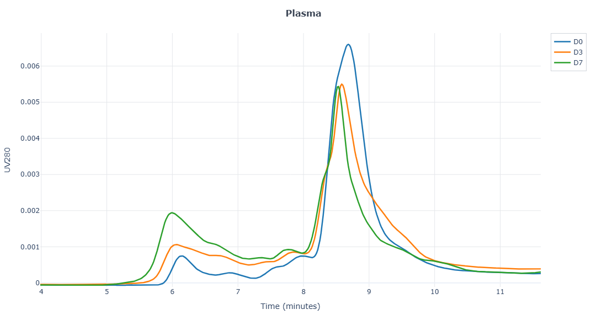
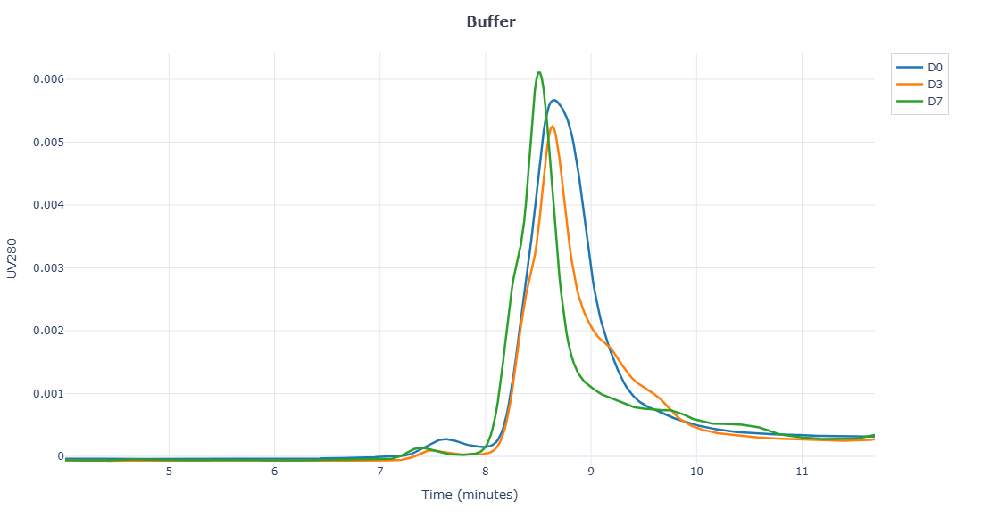
SI-212T14
Molecule | Plasma Stability (days) |  |  | Buffer Stability (days)
 | 0 | 3 | 7 | 0 | 3 | 7
SI-212T14 | 75 | 63 | 49 | 89 | 85 | 84
SI-54X1 | 91 | 81 | 79 | 94 | 88 | 85
SI-212X19 | 90 | 77 |  | 94 | 88
SI-212X13 | 87 | 82 | 77 | 93 | 89 | 85
SI-50E15 | 89 | 79 | 70 | 95 | 95 | 92
SI-212X20 | 83 | 62 |  | 91 | 66
SI-212T12 | 82 | 63 | 60 | 96 | 86 | 78
SI-212SF1 | 87 | 82 | 56 | 98 | 90 | 89
SI-212X23 | 82 | 66 | 68 | 95 | 90 | 88
SI-212T26 | 75 | 71 | 65 | 89 | 83 | 83
SI-212T15 | 85 | 78 | 72 | 97 | 89 | 87
SI-212T29 |  | 71 | 68 | 88 | 83 | 78
SI-207X7 | 82 | 35 | 13 | 94 | 81 | 77
SI-207X8 | 80 | 34 | 17 | 92 | 92 | 61
SI-207X9 | 86 | 32 | 15 | 96 | 83 | 81
Molecule | Plasma Stability (days) |  |  | Buffer Stability (days)
 | 0 | 3 | 7 | 0 | 3 | 7
SI-212T14 | 0 | -12 | -26 | 0 | -4 | -5.2
SI-54X1 | 0 | -9.4 | -12 | 0 | -5.9 | -8.9
SI-212X19 | 0 | -13 |  | 0 | -6
SI-212X13 | 0 | -4.9 | -11 | 0 | -4.1 | -8.0
SI-50E15 | 0 | -9.5 | -19 | 0 | -0.5 | -3.0
SI-212X20 | 0 | -20 |  | 0 | -24
SI-212T12 | 0 | -20 | -22 | 0 | -9.9 | -17
SI-212SF1 | 0 | -4.8 | -31 | 0 | -8.1 | -8.7
SI-212X23 | 0 | -16 | -14 | 0 | -5.4 | -7.9
SI-212T26 | 0 | -4.0 | -9.6 | 0 | -6.7 | -6.9
SI-212T15 | 0 | -7.0 | -13 | 0 | -7.6 | -10
SI-212T29 |  |  |  | 0 | -5.1 | -9.6
SI-207X7 | 0 | -47 | -68 | 0 | -13 | -16
SI-207X8 | 0 | -47 | -63 | 0 | -0.6 | -31
SI-207X9 | 0 | -54 | -70 | 0 | -12 | -15

Slide 5
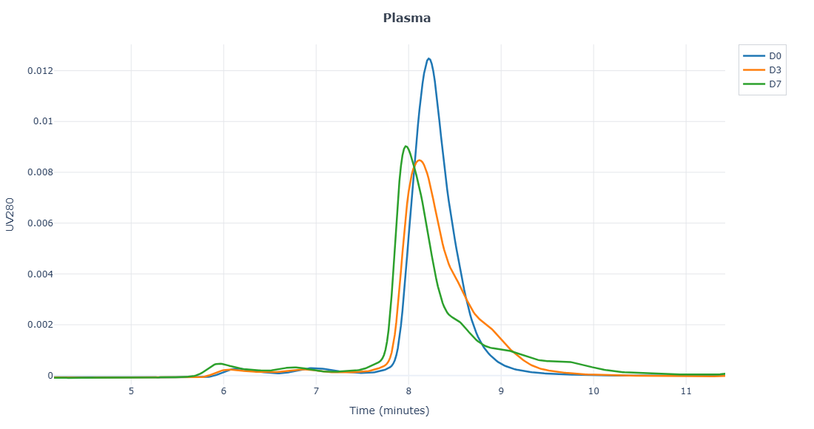
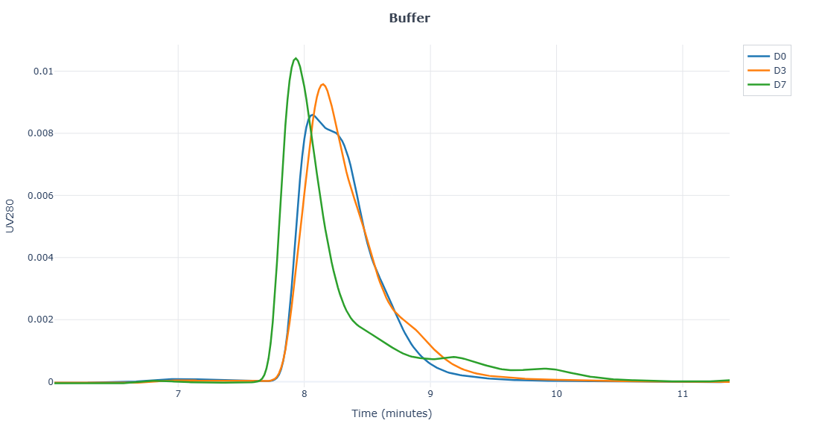
SI-54X1
Molecule | Plasma Stability (days) |  |  | Buffer Stability (days)
 | 0 | 3 | 7 | 0 | 3 | 7
SI-212T14 | 75 | 63 | 49 | 89 | 85 | 84
SI-54X1 | 91 | 81 | 79 | 94 | 88 | 85
SI-212X19 | 90 | 77 |  | 94 | 88
SI-212X13 | 87 | 82 | 77 | 93 | 89 | 85
SI-50E15 | 89 | 79 | 70 | 95 | 95 | 92
SI-212X20 | 83 | 62 |  | 91 | 66
SI-212T12 | 82 | 63 | 60 | 96 | 86 | 78
SI-212SF1 | 87 | 82 | 56 | 98 | 90 | 89
SI-212X23 | 82 | 66 | 68 | 95 | 90 | 88
SI-212T26 | 75 | 71 | 65 | 89 | 83 | 83
SI-212T15 | 85 | 78 | 72 | 97 | 89 | 87
SI-212T29 |  | 71 | 68 | 88 | 83 | 78
SI-207X7 | 82 | 35 | 13 | 94 | 81 | 77
SI-207X8 | 80 | 34 | 17 | 92 | 92 | 61
SI-207X9 | 86 | 32 | 15 | 96 | 83 | 81
Molecule | Plasma Stability (days) |  |  | Buffer Stability (days)
 | 0 | 3 | 7 | 0 | 3 | 7
SI-212T14 | 0 | -12 | -26 | 0 | -4 | -5.2
SI-54X1 | 0 | -9.4 | -12 | 0 | -5.9 | -8.9
SI-212X19 | 0 | -13 |  | 0 | -6
SI-212X13 | 0 | -4.9 | -11 | 0 | -4.1 | -8.0
SI-50E15 | 0 | -9.5 | -19 | 0 | -0.5 | -3.0
SI-212X20 | 0 | -20 |  | 0 | -24
SI-212T12 | 0 | -20 | -22 | 0 | -9.9 | -17
SI-212SF1 | 0 | -4.8 | -31 | 0 | -8.1 | -8.7
SI-212X23 | 0 | -16 | -14 | 0 | -5.4 | -7.9
SI-212T26 | 0 | -4.0 | -9.6 | 0 | -6.7 | -6.9
SI-212T15 | 0 | -7.0 | -13 | 0 | -7.6 | -10
SI-212T29 |  |  |  | 0 | -5.1 | -9.6
SI-207X7 | 0 | -47 | -68 | 0 | -13 | -16
SI-207X8 | 0 | -47 | -63 | 0 | -0.6 | -31
SI-207X9 | 0 | -54 | -70 | 0 | -12 | -15

Slide 6
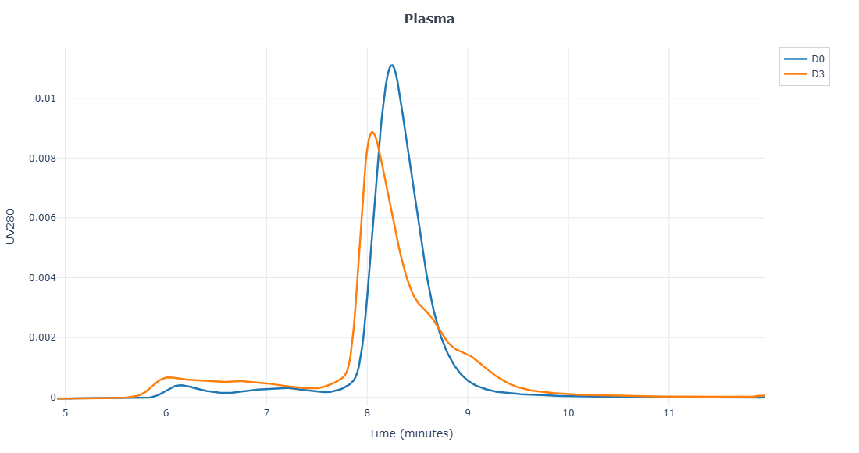
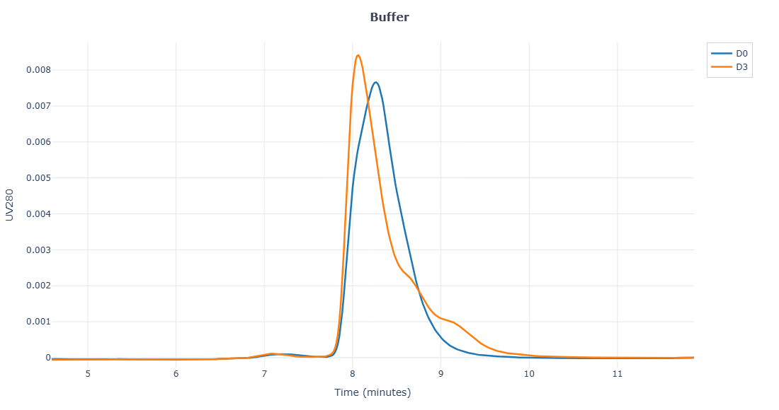
SI-212X19
Molecule | Plasma Stability (days) |  |  | Buffer Stability (days)
 | 0 | 3 | 7 | 0 | 3 | 7
SI-212T14 | 75 | 63 | 49 | 89 | 85 | 84
SI-54X1 | 91 | 81 | 79 | 94 | 88 | 85
SI-212X19 | 90 | 77 |  | 94 | 88
SI-212X13 | 87 | 82 | 77 | 93 | 89 | 85
SI-50E15 | 89 | 79 | 70 | 95 | 95 | 92
SI-212X20 | 83 | 62 |  | 91 | 66
SI-212T12 | 82 | 63 | 60 | 96 | 86 | 78
SI-212SF1 | 87 | 82 | 56 | 98 | 90 | 89
SI-212X23 | 82 | 66 | 68 | 95 | 90 | 88
SI-212T26 | 75 | 71 | 65 | 89 | 83 | 83
SI-212T15 | 85 | 78 | 72 | 97 | 89 | 87
SI-212T29 |  | 71 | 68 | 88 | 83 | 78
SI-207X7 | 82 | 35 | 13 | 94 | 81 | 77
SI-207X8 | 80 | 34 | 17 | 92 | 92 | 61
SI-207X9 | 86 | 32 | 15 | 96 | 83 | 81
Molecule | Plasma Stability (days) |  |  | Buffer Stability (days)
 | 0 | 3 | 7 | 0 | 3 | 7
SI-212T14 | 0 | -12 | -26 | 0 | -4 | -5.2
SI-54X1 | 0 | -9.4 | -12 | 0 | -5.9 | -8.9
SI-212X19 | 0 | -13 |  | 0 | -6
SI-212X13 | 0 | -4.9 | -11 | 0 | -4.1 | -8.0
SI-50E15 | 0 | -9.5 | -19 | 0 | -0.5 | -3.0
SI-212X20 | 0 | -20 |  | 0 | -24
SI-212T12 | 0 | -20 | -22 | 0 | -9.9 | -17
SI-212SF1 | 0 | -4.8 | -31 | 0 | -8.1 | -8.7
SI-212X23 | 0 | -16 | -14 | 0 | -5.4 | -7.9
SI-212T26 | 0 | -4.0 | -9.6 | 0 | -6.7 | -6.9
SI-212T15 | 0 | -7.0 | -13 | 0 | -7.6 | -10
SI-212T29 |  |  |  | 0 | -5.1 | -9.6
SI-207X7 | 0 | -47 | -68 | 0 | -13 | -16
SI-207X8 | 0 | -47 | -63 | 0 | -0.6 | -31
SI-207X9 | 0 | -54 | -70 | 0 | -12 | -15

Slide 7
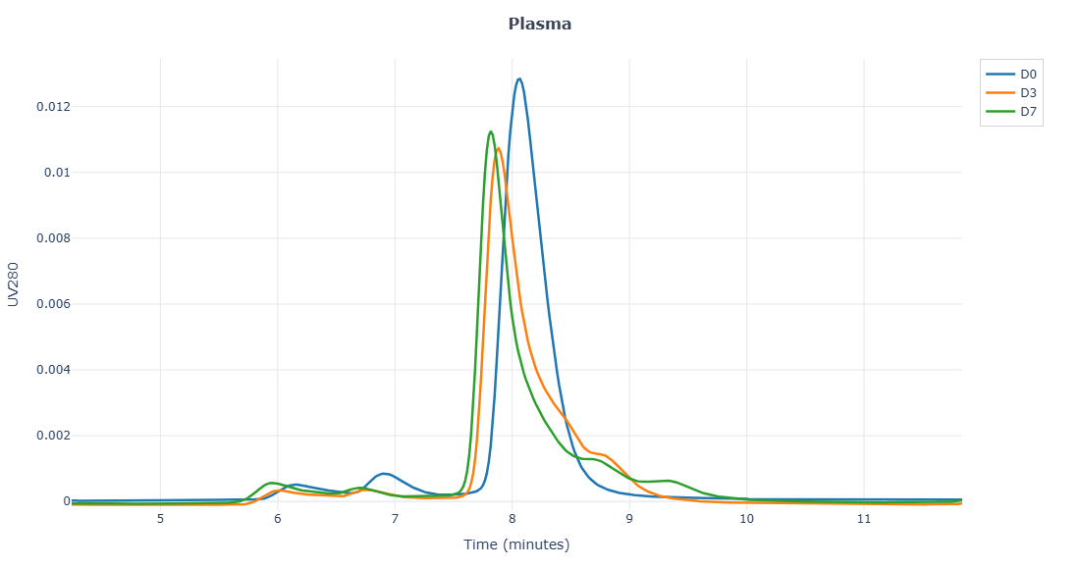
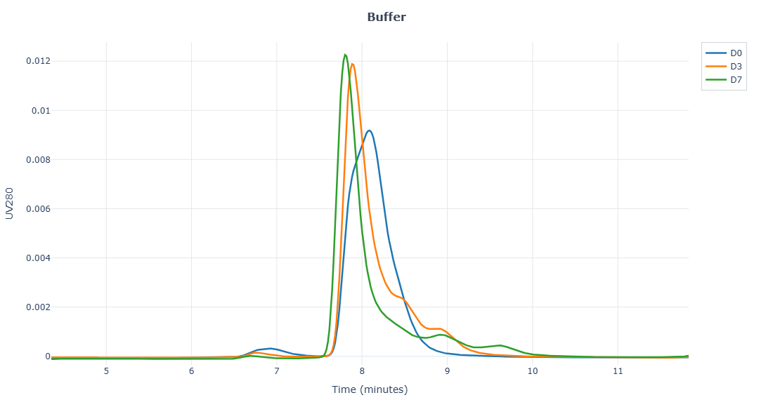
SI-212X13
Molecule | Plasma Stability (days) |  |  | Buffer Stability (days)
 | 0 | 3 | 7 | 0 | 3 | 7
SI-212T14 | 75 | 63 | 49 | 89 | 85 | 84
SI-54X1 | 91 | 81 | 79 | 94 | 88 | 85
SI-212X19 | 90 | 77 |  | 94 | 88
SI-212X13 | 87 | 82 | 77 | 93 | 89 | 85
SI-50E15 | 89 | 79 | 70 | 95 | 95 | 92
SI-212X20 | 83 | 62 |  | 91 | 66
SI-212T12 | 82 | 63 | 60 | 96 | 86 | 78
SI-212SF1 | 87 | 82 | 56 | 98 | 90 | 89
SI-212X23 | 82 | 66 | 68 | 95 | 90 | 88
SI-212T26 | 75 | 71 | 65 | 89 | 83 | 83
SI-212T15 | 85 | 78 | 72 | 97 | 89 | 87
SI-212T29 |  | 71 | 68 | 88 | 83 | 78
SI-207X7 | 82 | 35 | 13 | 94 | 81 | 77
SI-207X8 | 80 | 34 | 17 | 92 | 92 | 61
SI-207X9 | 86 | 32 | 15 | 96 | 83 | 81
Molecule | Plasma Stability (days) |  |  | Buffer Stability (days)
 | 0 | 3 | 7 | 0 | 3 | 7
SI-212T14 | 0 | -12 | -26 | 0 | -4 | -5.2
SI-54X1 | 0 | -9.4 | -12 | 0 | -5.9 | -8.9
SI-212X19 | 0 | -13 |  | 0 | -6
SI-212X13 | 0 | -4.9 | -11 | 0 | -4.1 | -8.0
SI-50E15 | 0 | -9.5 | -19 | 0 | -0.5 | -3.0
SI-212X20 | 0 | -20 |  | 0 | -24
SI-212T12 | 0 | -20 | -22 | 0 | -9.9 | -17
SI-212SF1 | 0 | -4.8 | -31 | 0 | -8.1 | -8.7
SI-212X23 | 0 | -16 | -14 | 0 | -5.4 | -7.9
SI-212T26 | 0 | -4.0 | -9.6 | 0 | -6.7 | -6.9
SI-212T15 | 0 | -7.0 | -13 | 0 | -7.6 | -10
SI-212T29 |  |  |  | 0 | -5.1 | -9.6
SI-207X7 | 0 | -47 | -68 | 0 | -13 | -16
SI-207X8 | 0 | -47 | -63 | 0 | -0.6 | -31
SI-207X9 | 0 | -54 | -70 | 0 | -12 | -15

Slide 8
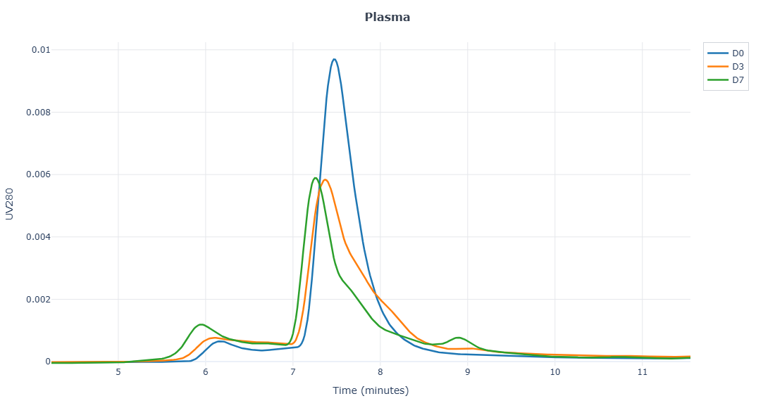
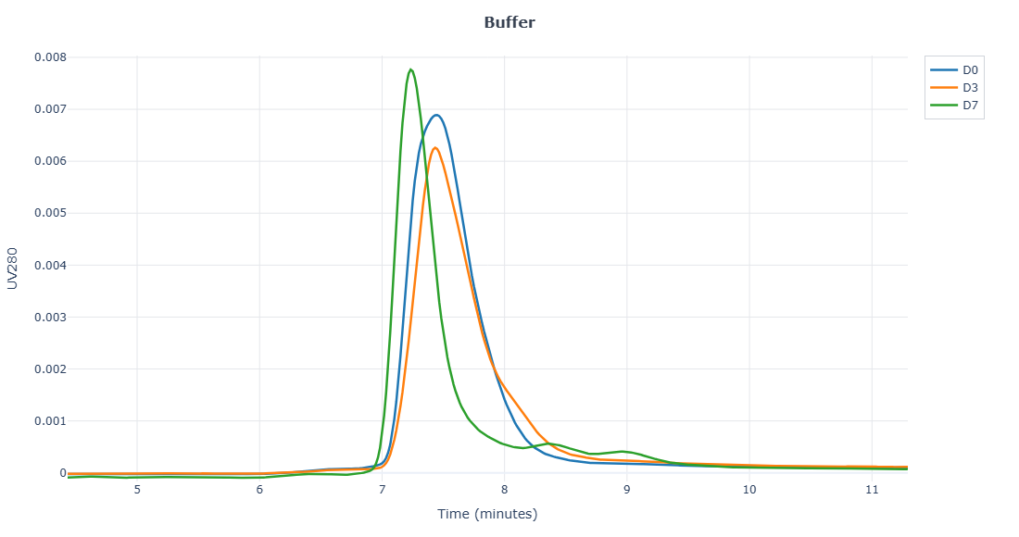
SI-50E15
Molecule | Plasma Stability (days) |  |  | Buffer Stability (days)
 | 0 | 3 | 7 | 0 | 3 | 7
SI-212T14 | 75 | 63 | 49 | 89 | 85 | 84
SI-54X1 | 91 | 81 | 79 | 94 | 88 | 85
SI-212X19 | 90 | 77 |  | 94 | 88
SI-212X13 | 87 | 82 | 77 | 93 | 89 | 85
SI-50E15 | 89 | 79 | 70 | 95 | 95 | 92
SI-212X20 | 83 | 62 |  | 91 | 66
SI-212T12 | 82 | 63 | 60 | 96 | 86 | 78
SI-212SF1 | 87 | 82 | 56 | 98 | 90 | 89
SI-212X23 | 82 | 66 | 68 | 95 | 90 | 88
SI-212T26 | 75 | 71 | 65 | 89 | 83 | 83
SI-212T15 | 85 | 78 | 72 | 97 | 89 | 87
SI-212T29 |  | 71 | 68 | 88 | 83 | 78
SI-207X7 | 82 | 35 | 13 | 94 | 81 | 77
SI-207X8 | 80 | 34 | 17 | 92 | 92 | 61
SI-207X9 | 86 | 32 | 15 | 96 | 83 | 81
Molecule | Plasma Stability (days) |  |  | Buffer Stability (days)
 | 0 | 3 | 7 | 0 | 3 | 7
SI-212T14 | 0 | -12 | -26 | 0 | -4 | -5.2
SI-54X1 | 0 | -9.4 | -12 | 0 | -5.9 | -8.9
SI-212X19 | 0 | -13 |  | 0 | -6
SI-212X13 | 0 | -4.9 | -11 | 0 | -4.1 | -8.0
SI-50E15 | 0 | -9.5 | -19 | 0 | -0.5 | -3.0
SI-212X20 | 0 | -20 |  | 0 | -24
SI-212T12 | 0 | -20 | -22 | 0 | -9.9 | -17
SI-212SF1 | 0 | -4.8 | -31 | 0 | -8.1 | -8.7
SI-212X23 | 0 | -16 | -14 | 0 | -5.4 | -7.9
SI-212T26 | 0 | -4.0 | -9.6 | 0 | -6.7 | -6.9
SI-212T15 | 0 | -7.0 | -13 | 0 | -7.6 | -10
SI-212T29 |  |  |  | 0 | -5.1 | -9.6
SI-207X7 | 0 | -47 | -68 | 0 | -13 | -16
SI-207X8 | 0 | -47 | -63 | 0 | -0.6 | -31
SI-207X9 | 0 | -54 | -70 | 0 | -12 | -15

Slide 9
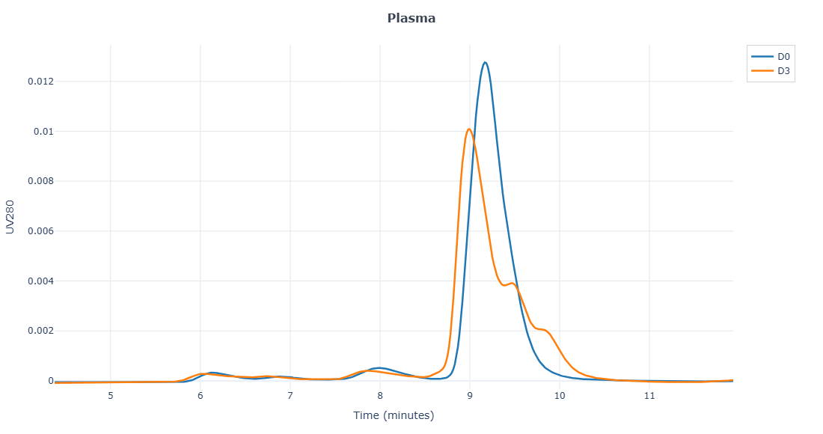
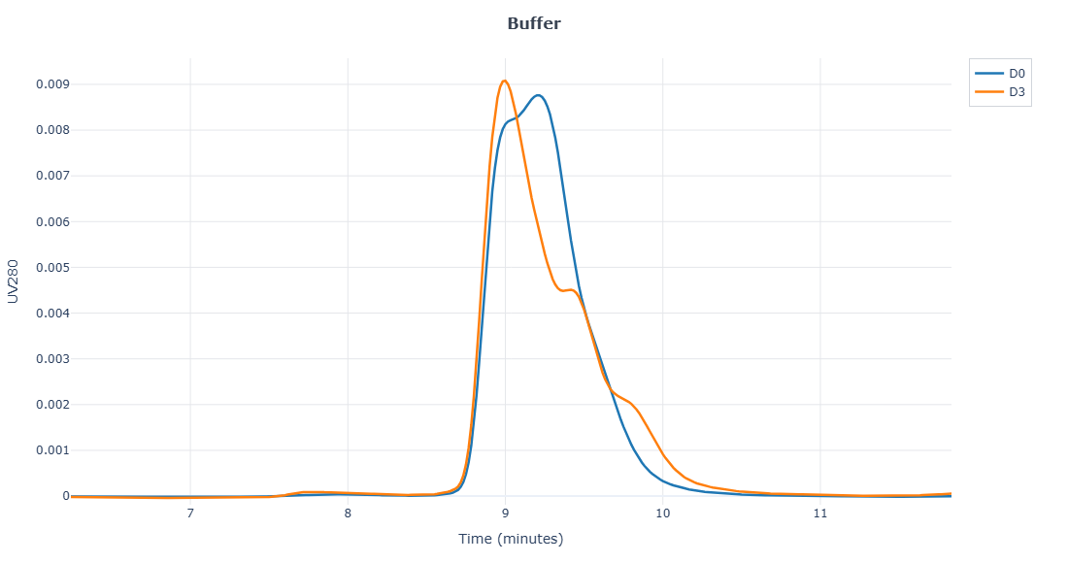
SI-212X20
Molecule | Plasma Stability (days) |  |  | Buffer Stability (days)
 | 0 | 3 | 7 | 0 | 3 | 7
SI-212T14 | 75 | 63 | 49 | 89 | 85 | 84
SI-54X1 | 91 | 81 | 79 | 94 | 88 | 85
SI-212X19 | 90 | 77 |  | 94 | 88
SI-212X13 | 87 | 82 | 77 | 93 | 89 | 85
SI-50E15 | 89 | 79 | 70 | 95 | 95 | 92
SI-212X20 | 83 | 62 |  | 91 | 66
SI-212T12 | 82 | 63 | 60 | 96 | 86 | 78
SI-212SF1 | 87 | 82 | 56 | 98 | 90 | 89
SI-212X23 | 82 | 66 | 68 | 95 | 90 | 88
SI-212T26 | 75 | 71 | 65 | 89 | 83 | 83
SI-212T15 | 85 | 78 | 72 | 97 | 89 | 87
SI-212T29 |  | 71 | 68 | 88 | 83 | 78
SI-207X7 | 82 | 35 | 13 | 94 | 81 | 77
SI-207X8 | 80 | 34 | 17 | 92 | 92 | 61
SI-207X9 | 86 | 32 | 15 | 96 | 83 | 81
Molecule | Plasma Stability (days) |  |  | Buffer Stability (days)
 | 0 | 3 | 7 | 0 | 3 | 7
SI-212T14 | 0 | -12 | -26 | 0 | -4 | -5.2
SI-54X1 | 0 | -9.4 | -12 | 0 | -5.9 | -8.9
SI-212X19 | 0 | -13 |  | 0 | -6
SI-212X13 | 0 | -4.9 | -11 | 0 | -4.1 | -8.0
SI-50E15 | 0 | -9.5 | -19 | 0 | -0.5 | -3.0
SI-212X20 | 0 | -20 |  | 0 | -24
SI-212T12 | 0 | -20 | -22 | 0 | -9.9 | -17
SI-212SF1 | 0 | -4.8 | -31 | 0 | -8.1 | -8.7
SI-212X23 | 0 | -16 | -14 | 0 | -5.4 | -7.9
SI-212T26 | 0 | -4.0 | -9.6 | 0 | -6.7 | -6.9
SI-212T15 | 0 | -7.0 | -13 | 0 | -7.6 | -10
SI-212T29 |  |  |  | 0 | -5.1 | -9.6
SI-207X7 | 0 | -47 | -68 | 0 | -13 | -16
SI-207X8 | 0 | -47 | -63 | 0 | -0.6 | -31
SI-207X9 | 0 | -54 | -70 | 0 | -12 | -15

Slide 10
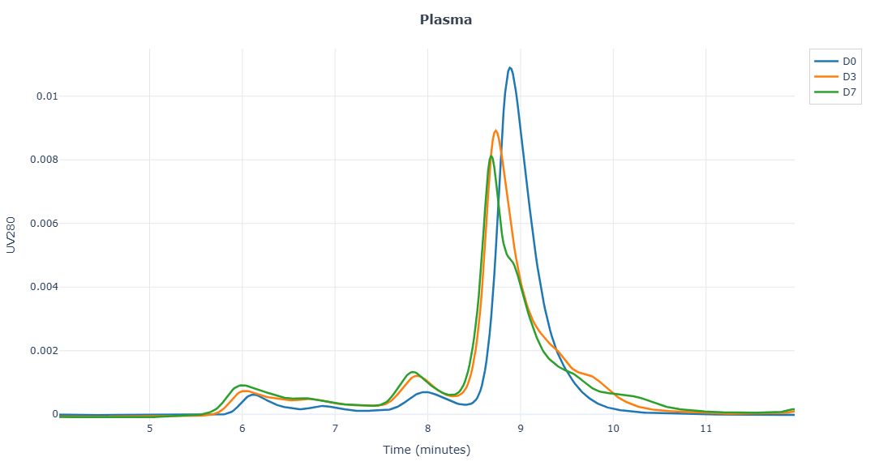
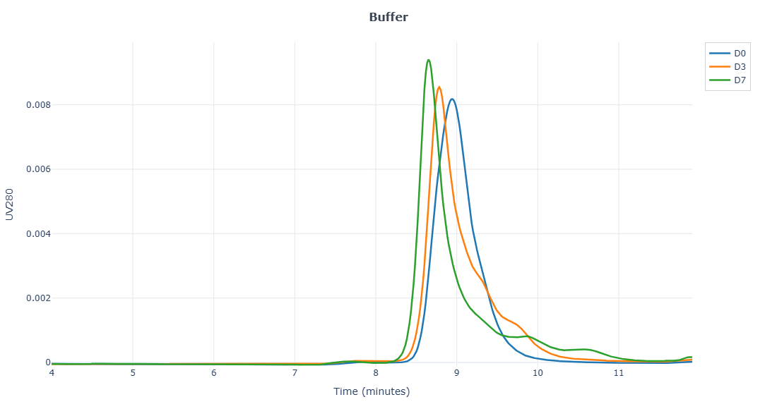
SI-212T12
Molecule | Plasma Stability (days) |  |  | Buffer Stability (days)
 | 0 | 3 | 7 | 0 | 3 | 7
SI-212T14 | 75 | 63 | 49 | 89 | 85 | 84
SI-54X1 | 91 | 81 | 79 | 94 | 88 | 85
SI-212X19 | 90 | 77 |  | 94 | 88
SI-212X13 | 87 | 82 | 77 | 93 | 89 | 85
SI-50E15 | 89 | 79 | 70 | 95 | 95 | 92
SI-212X20 | 83 | 62 |  | 91 | 66
SI-212T12 | 82 | 63 | 60 | 96 | 86 | 78
SI-212SF1 | 87 | 82 | 56 | 98 | 90 | 89
SI-212X23 | 82 | 66 | 68 | 95 | 90 | 88
SI-212T26 | 75 | 71 | 65 | 89 | 83 | 83
SI-212T15 | 85 | 78 | 72 | 97 | 89 | 87
SI-212T29 |  | 71 | 68 | 88 | 83 | 78
SI-207X7 | 82 | 35 | 13 | 94 | 81 | 77
SI-207X8 | 80 | 34 | 17 | 92 | 92 | 61
SI-207X9 | 86 | 32 | 15 | 96 | 83 | 81
Molecule | Plasma Stability (days) |  |  | Buffer Stability (days)
 | 0 | 3 | 7 | 0 | 3 | 7
SI-212T14 | 0 | -12 | -26 | 0 | -4 | -5.2
SI-54X1 | 0 | -9.4 | -12 | 0 | -5.9 | -8.9
SI-212X19 | 0 | -13 |  | 0 | -6
SI-212X13 | 0 | -4.9 | -11 | 0 | -4.1 | -8.0
SI-50E15 | 0 | -9.5 | -19 | 0 | -0.5 | -3.0
SI-212X20 | 0 | -20 |  | 0 | -24
SI-212T12 | 0 | -20 | -22 | 0 | -9.9 | -17
SI-212SF1 | 0 | -4.8 | -31 | 0 | -8.1 | -8.7
SI-212X23 | 0 | -16 | -14 | 0 | -5.4 | -7.9
SI-212T26 | 0 | -4.0 | -9.6 | 0 | -6.7 | -6.9
SI-212T15 | 0 | -7.0 | -13 | 0 | -7.6 | -10
SI-212T29 |  |  |  | 0 | -5.1 | -9.6
SI-207X7 | 0 | -47 | -68 | 0 | -13 | -16
SI-207X8 | 0 | -47 | -63 | 0 | -0.6 | -31
SI-207X9 | 0 | -54 | -70 | 0 | -12 | -15

Slide 11
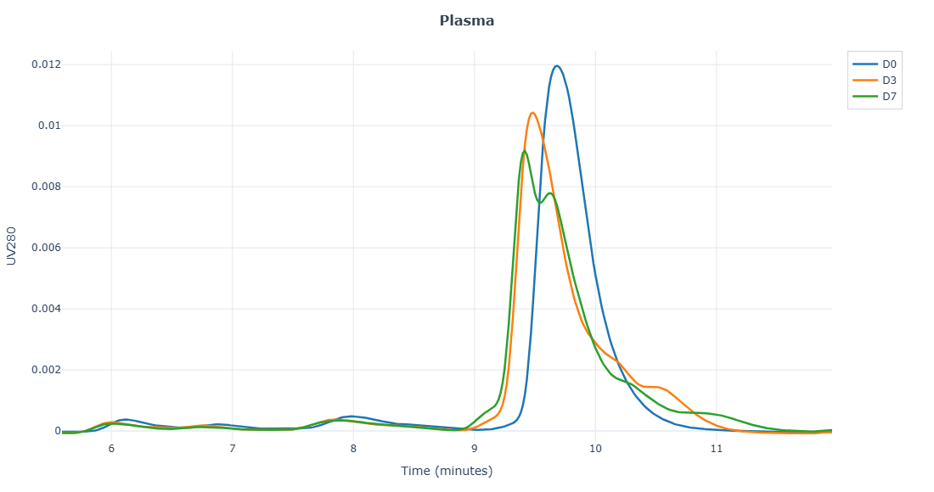
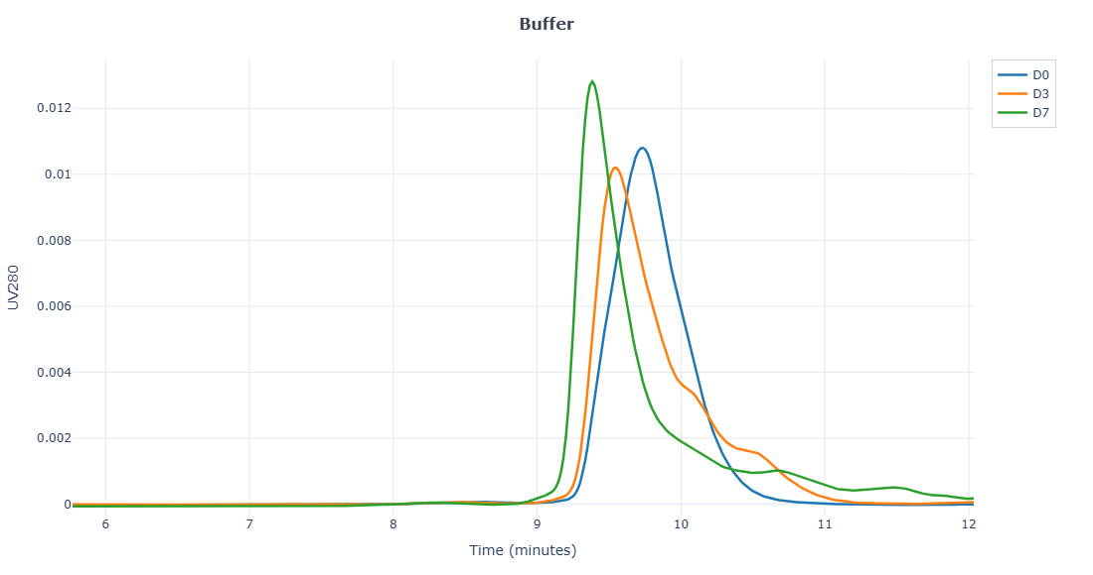
SI-212SF1
Molecule | Plasma Stability (days) |  |  | Buffer Stability (days)
 | 0 | 3 | 7 | 0 | 3 | 7
SI-212T14 | 75 | 63 | 49 | 89 | 85 | 84
SI-54X1 | 91 | 81 | 79 | 94 | 88 | 85
SI-212X19 | 90 | 77 |  | 94 | 88
SI-212X13 | 87 | 82 | 77 | 93 | 89 | 85
SI-50E15 | 89 | 79 | 70 | 95 | 95 | 92
SI-212X20 | 83 | 62 |  | 91 | 66
SI-212T12 | 82 | 63 | 60 | 96 | 86 | 78
SI-212SF1 | 87 | 82 | 56 | 98 | 90 | 89
SI-212X23 | 82 | 66 | 68 | 95 | 90 | 88
SI-212T26 | 75 | 71 | 65 | 89 | 83 | 83
SI-212T15 | 85 | 78 | 72 | 97 | 89 | 87
SI-212T29 |  | 71 | 68 | 88 | 83 | 78
SI-207X7 | 82 | 35 | 13 | 94 | 81 | 77
SI-207X8 | 80 | 34 | 17 | 92 | 92 | 61
SI-207X9 | 86 | 32 | 15 | 96 | 83 | 81
Molecule | Plasma Stability (days) |  |  | Buffer Stability (days)
 | 0 | 3 | 7 | 0 | 3 | 7
SI-212T14 | 0 | -12 | -26 | 0 | -4 | -5.2
SI-54X1 | 0 | -9.4 | -12 | 0 | -5.9 | -8.9
SI-212X19 | 0 | -13 |  | 0 | -6
SI-212X13 | 0 | -4.9 | -11 | 0 | -4.1 | -8.0
SI-50E15 | 0 | -9.5 | -19 | 0 | -0.5 | -3.0
SI-212X20 | 0 | -20 |  | 0 | -24
SI-212T12 | 0 | -20 | -22 | 0 | -9.9 | -17
SI-212SF1 | 0 | -4.8 | -31 | 0 | -8.1 | -8.7
SI-212X23 | 0 | -16 | -14 | 0 | -5.4 | -7.9
SI-212T26 | 0 | -4.0 | -9.6 | 0 | -6.7 | -6.9
SI-212T15 | 0 | -7.0 | -13 | 0 | -7.6 | -10
SI-212T29 |  |  |  | 0 | -5.1 | -9.6
SI-207X7 | 0 | -47 | -68 | 0 | -13 | -16
SI-207X8 | 0 | -47 | -63 | 0 | -0.6 | -31
SI-207X9 | 0 | -54 | -70 | 0 | -12 | -15

Slide 12
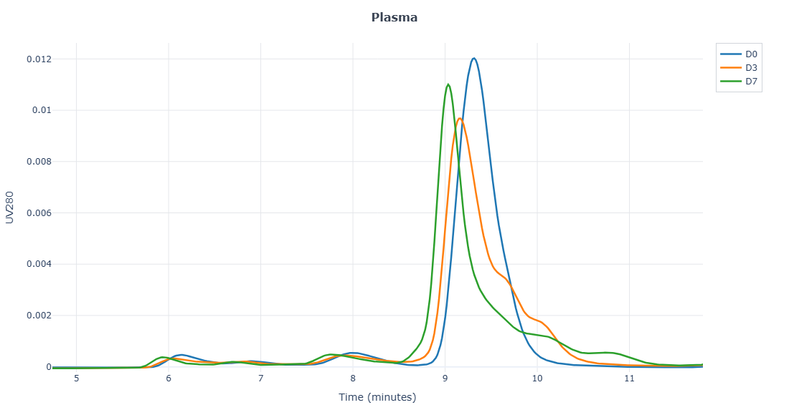
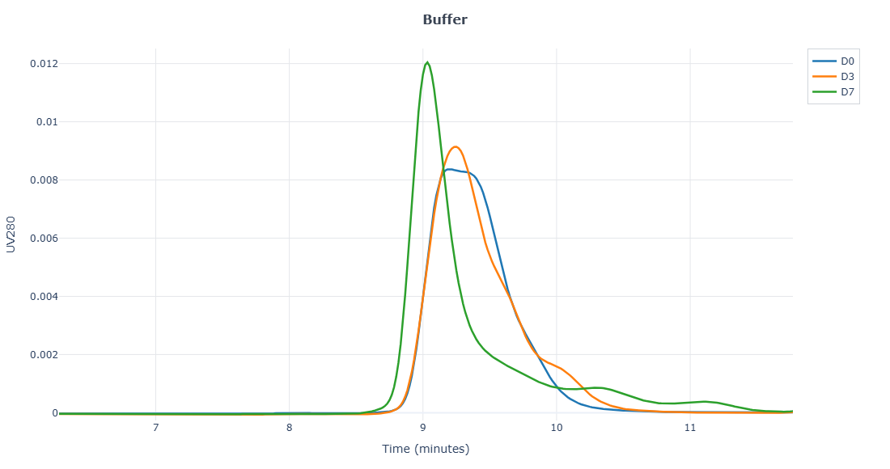
SI-212X23
Molecule | Plasma Stability (days) |  |  | Buffer Stability (days)
 | 0 | 3 | 7 | 0 | 3 | 7
SI-212T14 | 75 | 63 | 49 | 89 | 85 | 84
SI-54X1 | 91 | 81 | 79 | 94 | 88 | 85
SI-212X19 | 90 | 77 |  | 94 | 88
SI-212X13 | 87 | 82 | 77 | 93 | 89 | 85
SI-50E15 | 89 | 79 | 70 | 95 | 95 | 92
SI-212X20 | 83 | 62 |  | 91 | 66
SI-212T12 | 82 | 63 | 60 | 96 | 86 | 78
SI-212SF1 | 87 | 82 | 56 | 98 | 90 | 89
SI-212X23 | 82 | 66 | 68 | 95 | 90 | 88
SI-212T26 | 75 | 71 | 65 | 89 | 83 | 83
SI-212T15 | 85 | 78 | 72 | 97 | 89 | 87
SI-212T29 |  | 71 | 68 | 88 | 83 | 78
SI-207X7 | 82 | 35 | 13 | 94 | 81 | 77
SI-207X8 | 80 | 34 | 17 | 92 | 92 | 61
SI-207X9 | 86 | 32 | 15 | 96 | 83 | 81
Molecule | Plasma Stability (days) |  |  | Buffer Stability (days)
 | 0 | 3 | 7 | 0 | 3 | 7
SI-212T14 | 0 | -12 | -26 | 0 | -4 | -5.2
SI-54X1 | 0 | -9.4 | -12 | 0 | -5.9 | -8.9
SI-212X19 | 0 | -13 |  | 0 | -6
SI-212X13 | 0 | -4.9 | -11 | 0 | -4.1 | -8.0
SI-50E15 | 0 | -9.5 | -19 | 0 | -0.5 | -3.0
SI-212X20 | 0 | -20 |  | 0 | -24
SI-212T12 | 0 | -20 | -22 | 0 | -9.9 | -17
SI-212SF1 | 0 | -4.8 | -31 | 0 | -8.1 | -8.7
SI-212X23 | 0 | -16 | -14 | 0 | -5.4 | -7.9
SI-212T26 | 0 | -4.0 | -9.6 | 0 | -6.7 | -6.9
SI-212T15 | 0 | -7.0 | -13 | 0 | -7.6 | -10
SI-212T29 |  |  |  | 0 | -5.1 | -9.6
SI-207X7 | 0 | -47 | -68 | 0 | -13 | -16
SI-207X8 | 0 | -47 | -63 | 0 | -0.6 | -31
SI-207X9 | 0 | -54 | -70 | 0 | -12 | -15

Slide 13
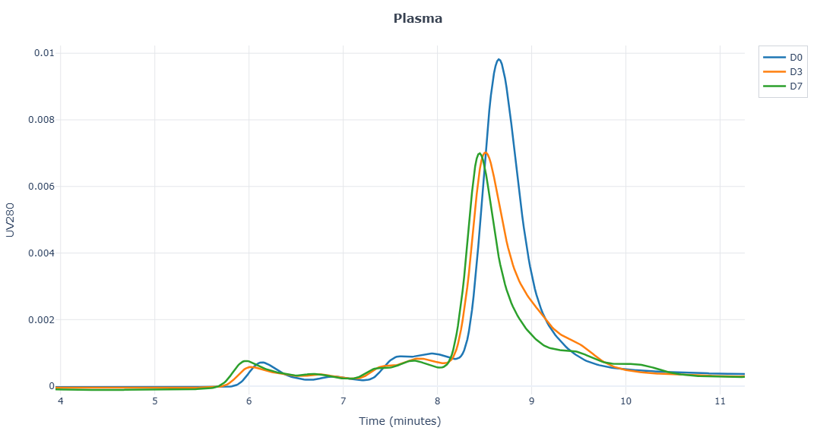
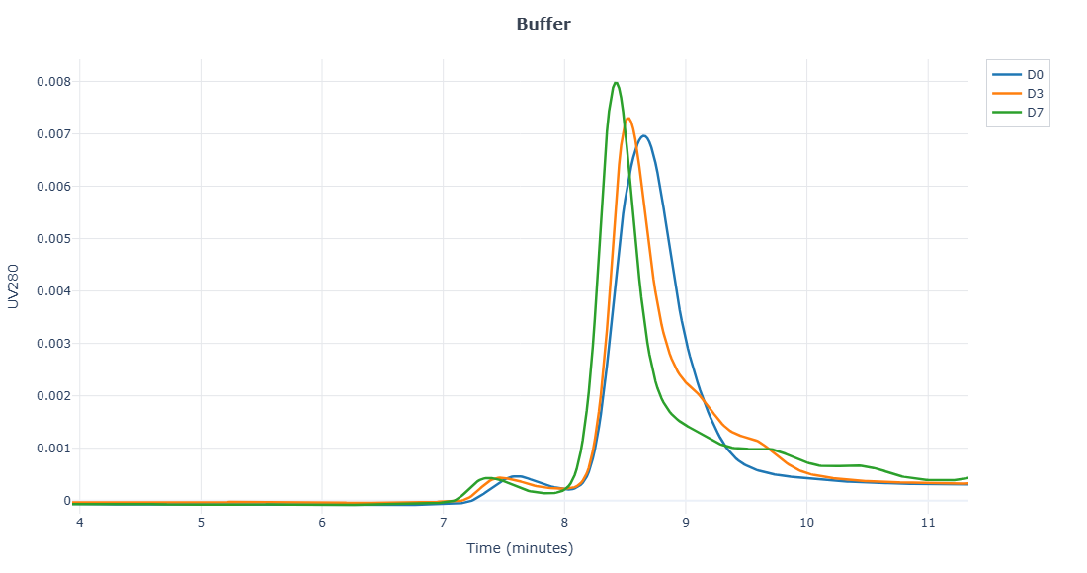
SI-212T26
Molecule | Plasma Stability (days) |  |  | Buffer Stability (days)
 | 0 | 3 | 7 | 0 | 3 | 7
SI-212T14 | 75 | 63 | 49 | 89 | 85 | 84
SI-54X1 | 91 | 81 | 79 | 94 | 88 | 85
SI-212X19 | 90 | 77 |  | 94 | 88
SI-212X13 | 87 | 82 | 77 | 93 | 89 | 85
SI-50E15 | 89 | 79 | 70 | 95 | 95 | 92
SI-212X20 | 83 | 62 |  | 91 | 66
SI-212T12 | 82 | 63 | 60 | 96 | 86 | 78
SI-212SF1 | 87 | 82 | 56 | 98 | 90 | 89
SI-212X23 | 82 | 66 | 68 | 95 | 90 | 88
SI-212T26 | 75 | 71 | 65 | 89 | 83 | 83
SI-212T15 | 85 | 78 | 72 | 97 | 89 | 87
SI-212T29 |  | 71 | 68 | 88 | 83 | 78
SI-207X7 | 82 | 35 | 13 | 94 | 81 | 77
SI-207X8 | 80 | 34 | 17 | 92 | 92 | 61
SI-207X9 | 86 | 32 | 15 | 96 | 83 | 81
Molecule | Plasma Stability (days) |  |  | Buffer Stability (days)
 | 0 | 3 | 7 | 0 | 3 | 7
SI-212T14 | 0 | -12 | -26 | 0 | -4 | -5.2
SI-54X1 | 0 | -9.4 | -12 | 0 | -5.9 | -8.9
SI-212X19 | 0 | -13 |  | 0 | -6
SI-212X13 | 0 | -4.9 | -11 | 0 | -4.1 | -8.0
SI-50E15 | 0 | -9.5 | -19 | 0 | -0.5 | -3.0
SI-212X20 | 0 | -20 |  | 0 | -24
SI-212T12 | 0 | -20 | -22 | 0 | -9.9 | -17
SI-212SF1 | 0 | -4.8 | -31 | 0 | -8.1 | -8.7
SI-212X23 | 0 | -16 | -14 | 0 | -5.4 | -7.9
SI-212T26 | 0 | -4.0 | -9.6 | 0 | -6.7 | -6.9
SI-212T15 | 0 | -7.0 | -13 | 0 | -7.6 | -10
SI-212T29 |  |  |  | 0 | -5.1 | -9.6
SI-207X7 | 0 | -47 | -68 | 0 | -13 | -16
SI-207X8 | 0 | -47 | -63 | 0 | -0.6 | -31
SI-207X9 | 0 | -54 | -70 | 0 | -12 | -15

Slide 14
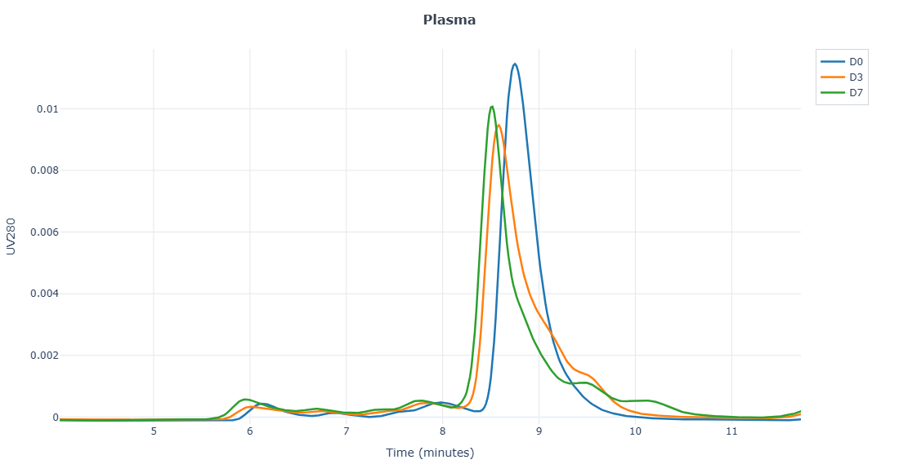
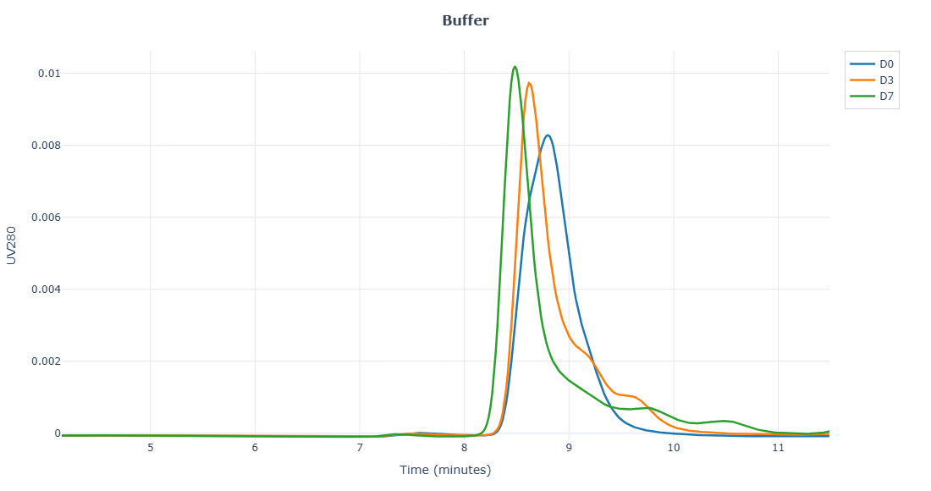
SI-212T15
Molecule | Plasma Stability (days) |  |  | Buffer Stability (days)
 | 0 | 3 | 7 | 0 | 3 | 7
SI-212T14 | 75 | 63 | 49 | 89 | 85 | 84
SI-54X1 | 91 | 81 | 79 | 94 | 88 | 85
SI-212X19 | 90 | 77 |  | 94 | 88
SI-212X13 | 87 | 82 | 77 | 93 | 89 | 85
SI-50E15 | 89 | 79 | 70 | 95 | 95 | 92
SI-212X20 | 83 | 62 |  | 91 | 66
SI-212T12 | 82 | 63 | 60 | 96 | 86 | 78
SI-212SF1 | 87 | 82 | 56 | 98 | 90 | 89
SI-212X23 | 82 | 66 | 68 | 95 | 90 | 88
SI-212T26 | 75 | 71 | 65 | 89 | 83 | 83
SI-212T15 | 85 | 78 | 72 | 97 | 89 | 87
SI-212T29 |  | 71 | 68 | 88 | 83 | 78
SI-207X7 | 82 | 35 | 13 | 94 | 81 | 77
SI-207X8 | 80 | 34 | 17 | 92 | 92 | 61
SI-207X9 | 86 | 32 | 15 | 96 | 83 | 81
Molecule | Plasma Stability (days) |  |  | Buffer Stability (days)
 | 0 | 3 | 7 | 0 | 3 | 7
SI-212T14 | 0 | -12 | -26 | 0 | -4 | -5.2
SI-54X1 | 0 | -9.4 | -12 | 0 | -5.9 | -8.9
SI-212X19 | 0 | -13 |  | 0 | -6
SI-212X13 | 0 | -4.9 | -11 | 0 | -4.1 | -8.0
SI-50E15 | 0 | -9.5 | -19 | 0 | -0.5 | -3.0
SI-212X20 | 0 | -20 |  | 0 | -24
SI-212T12 | 0 | -20 | -22 | 0 | -9.9 | -17
SI-212SF1 | 0 | -4.8 | -31 | 0 | -8.1 | -8.7
SI-212X23 | 0 | -16 | -14 | 0 | -5.4 | -7.9
SI-212T26 | 0 | -4.0 | -9.6 | 0 | -6.7 | -6.9
SI-212T15 | 0 | -7.0 | -13 | 0 | -7.6 | -10
SI-212T29 |  |  |  | 0 | -5.1 | -9.6
SI-207X7 | 0 | -47 | -68 | 0 | -13 | -16
SI-207X8 | 0 | -47 | -63 | 0 | -0.6 | -31
SI-207X9 | 0 | -54 | -70 | 0 | -12 | -15

Slide 15
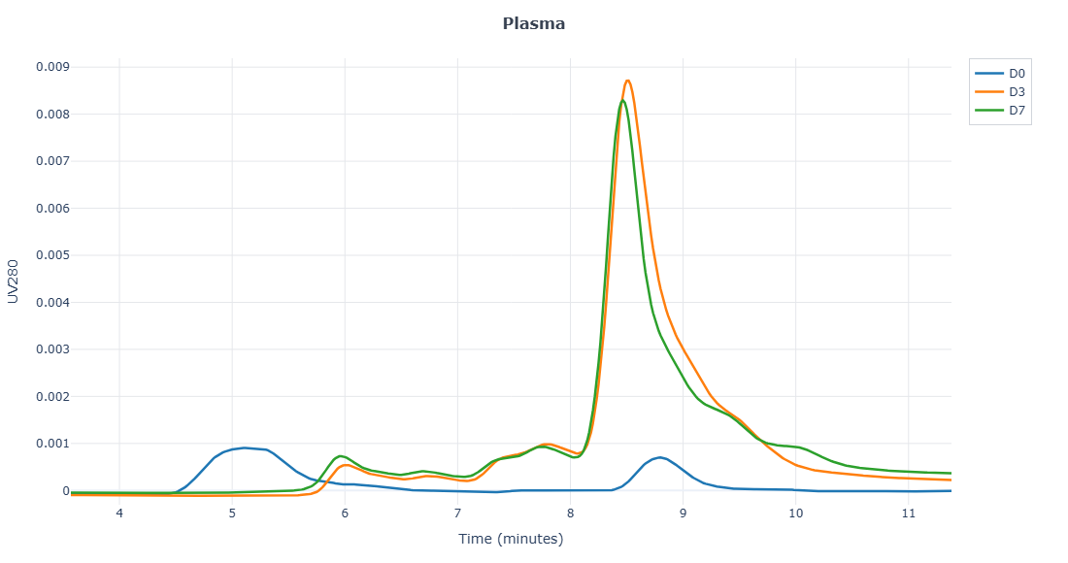
SI-212T29
Molecule | Plasma Stability (days) |  |  | Buffer Stability (days)
 | 0 | 3 | 7 | 0 | 3 | 7
SI-212T14 | 75 | 63 | 49 | 89 | 85 | 84
SI-54X1 | 91 | 81 | 79 | 94 | 88 | 85
SI-212X19 | 90 | 77 |  | 94 | 88
SI-212X13 | 87 | 82 | 77 | 93 | 89 | 85
SI-50E15 | 89 | 79 | 70 | 95 | 95 | 92
SI-212X20 | 83 | 62 |  | 91 | 66
SI-212T12 | 82 | 63 | 60 | 96 | 86 | 78
SI-212SF1 | 87 | 82 | 56 | 98 | 90 | 89
SI-212X23 | 82 | 66 | 68 | 95 | 90 | 88
SI-212T26 | 75 | 71 | 65 | 89 | 83 | 83
SI-212T15 | 85 | 78 | 72 | 97 | 89 | 87
SI-212T29 |  | 71 | 68 | 88 | 83 | 78
SI-207X7 | 82 | 35 | 13 | 94 | 81 | 77
SI-207X8 | 80 | 34 | 17 | 92 | 92 | 61
SI-207X9 | 86 | 32 | 15 | 96 | 83 | 81
*Plasma T0 needs to be re-run
Molecule | Plasma Stability (days) |  |  | Buffer Stability (days)
 | 0 | 3 | 7 | 0 | 3 | 7
SI-212T14 | 0 | -12 | -26 | 0 | -4 | -5.2
SI-54X1 | 0 | -9.4 | -12 | 0 | -5.9 | -8.9
SI-212X19 | 0 | -13 |  | 0 | -6
SI-212X13 | 0 | -4.9 | -11 | 0 | -4.1 | -8.0
SI-50E15 | 0 | -9.5 | -19 | 0 | -0.5 | -3.0
SI-212X20 | 0 | -20 |  | 0 | -24
SI-212T12 | 0 | -20 | -22 | 0 | -9.9 | -17
SI-212SF1 | 0 | -4.8 | -31 | 0 | -8.1 | -8.7
SI-212X23 | 0 | -16 | -14 | 0 | -5.4 | -7.9
SI-212T26 | 0 | -4.0 | -9.6 | 0 | -6.7 | -6.9
SI-212T15 | 0 | -7.0 | -13 | 0 | -7.6 | -10
SI-212T29 |  |  |  | 0 | -5.1 | -9.6
SI-207X7 | 0 | -47 | -68 | 0 | -13 | -16
SI-207X8 | 0 | -47 | -63 | 0 | -0.6 | -31
SI-207X9 | 0 | -54 | -70 | 0 | -12 | -15

Slide 16
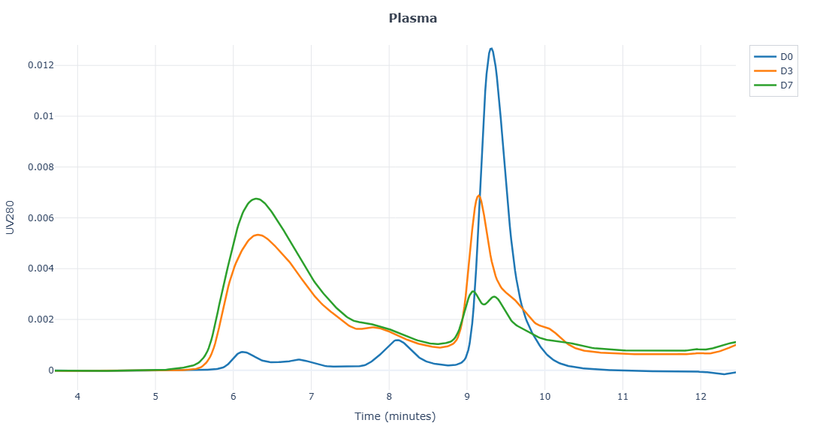
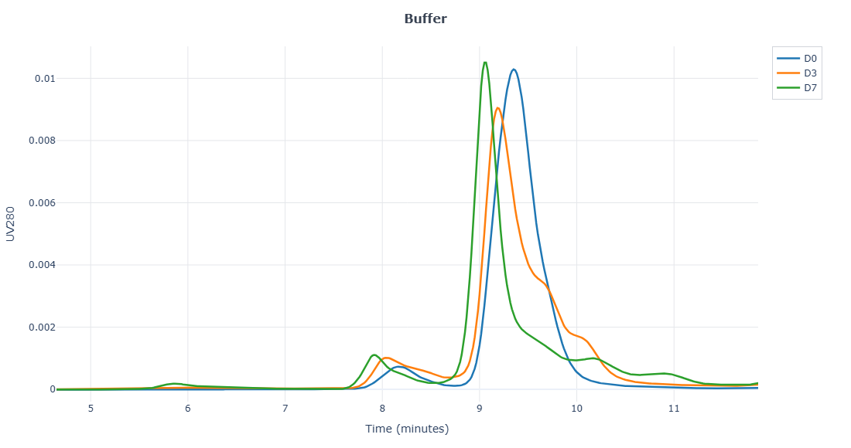
SI-207X7
Molecule | Plasma Stability (days) |  |  | Buffer Stability (days)
 | 0 | 3 | 7 | 0 | 3 | 7
SI-212T14 | 75 | 63 | 49 | 89 | 85 | 84
SI-54X1 | 91 | 81 | 79 | 94 | 88 | 85
SI-212X19 | 90 | 77 |  | 94 | 88
SI-212X13 | 87 | 82 | 77 | 93 | 89 | 85
SI-50E15 | 89 | 79 | 70 | 95 | 95 | 92
SI-212X20 | 83 | 62 |  | 91 | 66
SI-212T12 | 82 | 63 | 60 | 96 | 86 | 78
SI-212SF1 | 87 | 82 | 56 | 98 | 90 | 89
SI-212X23 | 82 | 66 | 68 | 95 | 90 | 88
SI-212T26 | 75 | 71 | 65 | 89 | 83 | 83
SI-212T15 | 85 | 78 | 72 | 97 | 89 | 87
SI-212T29 |  | 71 | 68 | 88 | 83 | 78
SI-207X7 | 82 | 35 | 13 | 94 | 81 | 77
SI-207X8 | 80 | 34 | 17 | 92 | 92 | 61
SI-207X9 | 86 | 32 | 15 | 96 | 83 | 81
Molecule | Plasma Stability (days) |  |  | Buffer Stability (days)
 | 0 | 3 | 7 | 0 | 3 | 7
SI-212T14 | 0 | -12 | -26 | 0 | -4 | -5.2
SI-54X1 | 0 | -9.4 | -12 | 0 | -5.9 | -8.9
SI-212X19 | 0 | -13 |  | 0 | -6
SI-212X13 | 0 | -4.9 | -11 | 0 | -4.1 | -8.0
SI-50E15 | 0 | -9.5 | -19 | 0 | -0.5 | -3.0
SI-212X20 | 0 | -20 |  | 0 | -24
SI-212T12 | 0 | -20 | -22 | 0 | -9.9 | -17
SI-212SF1 | 0 | -4.8 | -31 | 0 | -8.1 | -8.7
SI-212X23 | 0 | -16 | -14 | 0 | -5.4 | -7.9
SI-212T26 | 0 | -4.0 | -9.6 | 0 | -6.7 | -6.9
SI-212T15 | 0 | -7.0 | -13 | 0 | -7.6 | -10
SI-212T29 |  |  |  | 0 | -5.1 | -9.6
SI-207X7 | 0 | -47 | -68 | 0 | -13 | -16
SI-207X8 | 0 | -47 | -63 | 0 | -0.6 | -31
SI-207X9 | 0 | -54 | -70 | 0 | -12 | -15

Slide 17
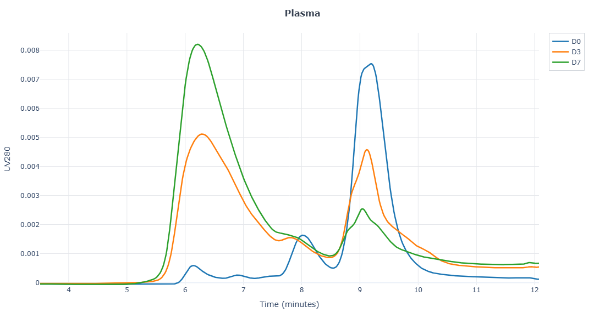
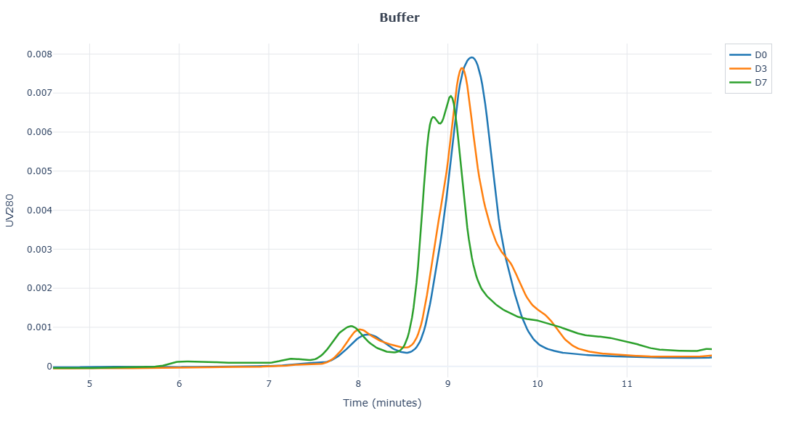
SI-207X8
Molecule | Plasma Stability (days) |  |  | Buffer Stability (days)
 | 0 | 3 | 7 | 0 | 3 | 7
SI-212T14 | 75 | 63 | 49 | 89 | 85 | 84
SI-54X1 | 91 | 81 | 79 | 94 | 88 | 85
SI-212X19 | 90 | 77 |  | 94 | 88
SI-212X13 | 87 | 82 | 77 | 93 | 89 | 85
SI-50E15 | 89 | 79 | 70 | 95 | 95 | 92
SI-212X20 | 83 | 62 |  | 91 | 66
SI-212T12 | 82 | 63 | 60 | 96 | 86 | 78
SI-212SF1 | 87 | 82 | 56 | 98 | 90 | 89
SI-212X23 | 82 | 66 | 68 | 95 | 90 | 88
SI-212T26 | 75 | 71 | 65 | 89 | 83 | 83
SI-212T15 | 85 | 78 | 72 | 97 | 89 | 87
SI-212T29 |  | 71 | 68 | 88 | 83 | 78
SI-207X7 | 82 | 35 | 13 | 94 | 81 | 77
SI-207X8 | 80 | 34 | 17 | 92 | 92 | 61
SI-207X9 | 86 | 32 | 15 | 96 | 83 | 81
Molecule | Plasma Stability (days) |  |  | Buffer Stability (days)
 | 0 | 3 | 7 | 0 | 3 | 7
SI-212T14 | 0 | -12 | -26 | 0 | -4 | -5.2
SI-54X1 | 0 | -9.4 | -12 | 0 | -5.9 | -8.9
SI-212X19 | 0 | -13 |  | 0 | -6
SI-212X13 | 0 | -4.9 | -11 | 0 | -4.1 | -8.0
SI-50E15 | 0 | -9.5 | -19 | 0 | -0.5 | -3.0
SI-212X20 | 0 | -20 |  | 0 | -24
SI-212T12 | 0 | -20 | -22 | 0 | -9.9 | -17
SI-212SF1 | 0 | -4.8 | -31 | 0 | -8.1 | -8.7
SI-212X23 | 0 | -16 | -14 | 0 | -5.4 | -7.9
SI-212T26 | 0 | -4.0 | -9.6 | 0 | -6.7 | -6.9
SI-212T15 | 0 | -7.0 | -13 | 0 | -7.6 | -10
SI-212T29 |  |  |  | 0 | -5.1 | -9.6
SI-207X7 | 0 | -47 | -68 | 0 | -13 | -16
SI-207X8 | 0 | -47 | -63 | 0 | -0.6 | -31
SI-207X9 | 0 | -54 | -70 | 0 | -12 | -15

Slide 18
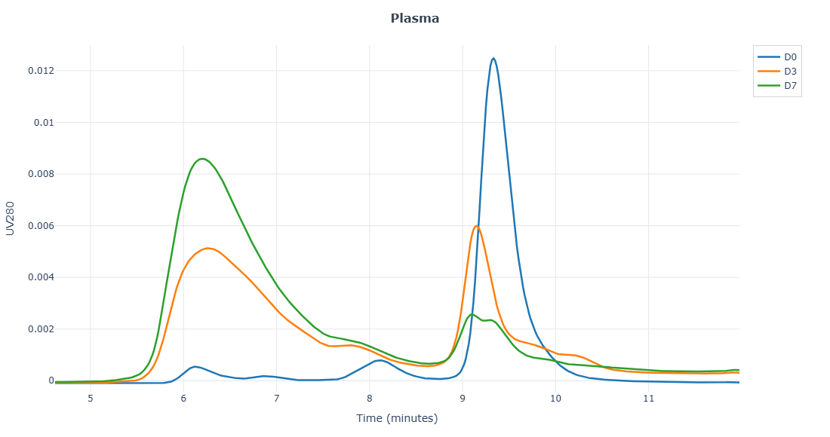
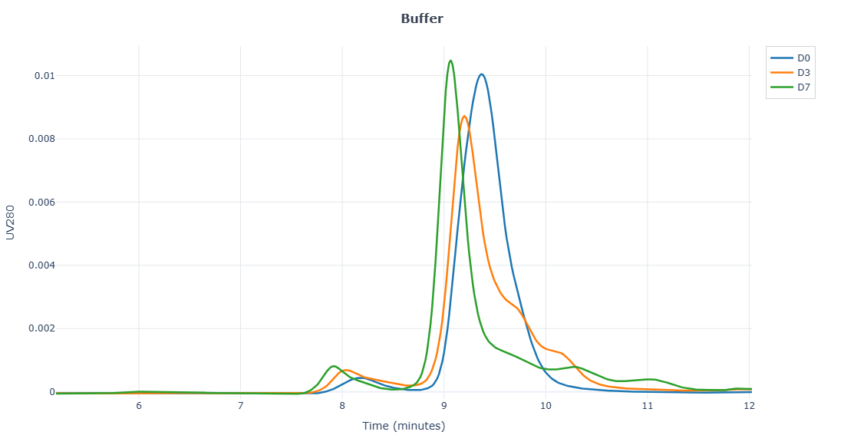
SI-207X9
Molecule | Plasma Stability (days) |  |  | Buffer Stability (days)
 | 0 | 3 | 7 | 0 | 3 | 7
SI-212T14 | 75 | 63 | 49 | 89 | 85 | 84
SI-54X1 | 91 | 81 | 79 | 94 | 88 | 85
SI-212X19 | 90 | 77 |  | 94 | 88
SI-212X13 | 87 | 82 | 77 | 93 | 89 | 85
SI-50E15 | 89 | 79 | 70 | 95 | 95 | 92
SI-212X20 | 83 | 62 |  | 91 | 66
SI-212T12 | 82 | 63 | 60 | 96 | 86 | 78
SI-212SF1 | 87 | 82 | 56 | 98 | 90 | 89
SI-212X23 | 82 | 66 | 68 | 95 | 90 | 88
SI-212T26 | 75 | 71 | 65 | 89 | 83 | 83
SI-212T15 | 85 | 78 | 72 | 97 | 89 | 87
SI-212T29 |  | 71 | 68 | 88 | 83 | 78
SI-207X7 | 82 | 35 | 13 | 94 | 81 | 77
SI-207X8 | 80 | 34 | 17 | 92 | 92 | 61
SI-207X9 | 86 | 32 | 15 | 96 | 83 | 81
Molecule | Plasma Stability (days) |  |  | Buffer Stability (days)
 | 0 | 3 | 7 | 0 | 3 | 7
SI-212T14 | 0 | -12 | -26 | 0 | -4 | -5.2
SI-54X1 | 0 | -9.4 | -12 | 0 | -5.9 | -8.9
SI-212X19 | 0 | -13 |  | 0 | -6
SI-212X13 | 0 | -4.9 | -11 | 0 | -4.1 | -8.0
SI-50E15 | 0 | -9.5 | -19 | 0 | -0.5 | -3.0
SI-212X20 | 0 | -20 |  | 0 | -24
SI-212T12 | 0 | -20 | -22 | 0 | -9.9 | -17
SI-212SF1 | 0 | -4.8 | -31 | 0 | -8.1 | -8.7
SI-212X23 | 0 | -16 | -14 | 0 | -5.4 | -7.9
SI-212T26 | 0 | -4.0 | -9.6 | 0 | -6.7 | -6.9
SI-212T15 | 0 | -7.0 | -13 | 0 | -7.6 | -10
SI-212T29 |  |  |  | 0 | -5.1 | -9.6
SI-207X7 | 0 | -47 | -68 | 0 | -13 | -16
SI-207X8 | 0 | -47 | -63 | 0 | -0.6 | -31
SI-207X9 | 0 | -54 | -70 | 0 | -12 | -15

